Slide 1
Week 14 – AP Macroeconomics

Slide 2
Unit 4
This unit is focused on the banking system and the definition, use of and supply of money.
We will go into depth about the other stabilization policy: Monetary Policy.

Slide 3
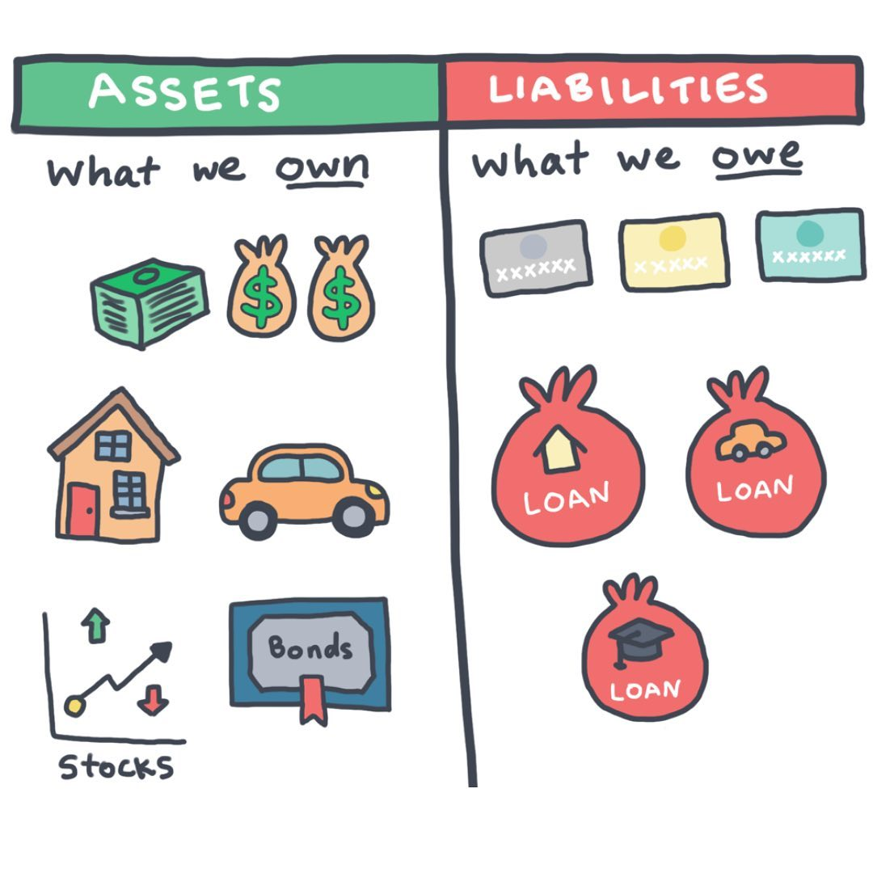
Assets
Assets are things that an individual has that has a positive value:
Eg. Phone, money, house, car, stocks, gold, pokemon cards, equipment, brand names, etc.
We sometimes refer to things such as good health, intelligence, bravery as assets also.
The more assets the better!
The opposite of an asset is a liability, which has a negative value.
Eg. A loan from a bank, money you owe to a friend
Summary
Asset = something that an individual or business has with positive value
Liability = something that an individual or business has with negative value

Slide 4
Give an example of an asset.
Money, a house, a car, a phone, stocks, equipment in a factory, inventory
Give an example of a liability.
Loans, money owed to suppliers

Slide 5
What is money?
Money (That's What I Want) - Barrett Strong // *Lyrics-video by Motley Stew* - YouTube
We have a general idea of what money is. We know we want more of it. We know we can buy things with it.
We will build on this existing knowledge to learn more about money specific to how the economy operates.

Slide 6
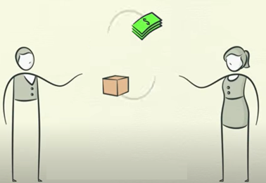
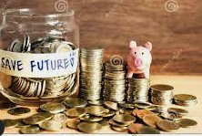

Roles of Money
Summary
Money has 3 main roles.
Money eliminates the need to barter (trade items for each other) which is efficient.
Definition of Money
Anything that can universally be used as a medium of exchange.
Roles of Money
Medium of Exchange – used to buy goods and services
Store of Value – we can hold money and spend it in the future.
Unit of Account – we can measure the value of things using money.
Barter
Without money we would be forced to barter for goods and services.
Eg. I want some apples so I trade you for some rice.
However, this creates problems when you don’t want rice!
Money eliminates this problem because everyone accepts money.
Certain things can be used as payment such as gift cards but are not universally accepted and so are called ‘near monies’.
Note: Inflation will cause both unit of account and store of value roles of money to no longer be as effective.

Slide 7
What are the three main uses of money?
Medium of exchange – buying things
Store of value – save for the future
Unit of Account – measure the value of things in dollars/yuan/euros etc.
Supposing there is unpredictable and high inflation in the economy. Which roles of money are most affected?
Store of value – savings eroded
Unit of account – price change is from real change in value or just inflation?
Is a gift card that is accepted at some stores only considered money?
It is not universally accepted as a medium of exchange and so it is considered ‘near monies’.

Slide 8
Bonus Activity: Barter Economy

Slide 9
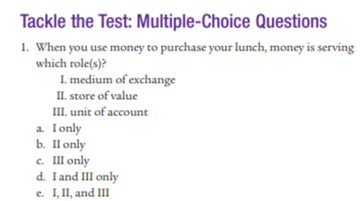
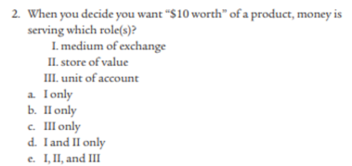
Mod 23
Answer: a
Answer: c

Slide 10
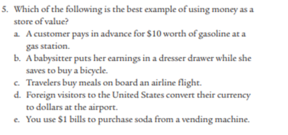
Mod 23
Answer: b

Slide 11
4. If Eric is using money to purchase gasoline for his car he is using money as
a unit of account.
a medium of exchange.
a transfer of profit
a store of value
an interest bearing asset

Slide 12
Define the following uses of money
You go to a cinema and watch a movie which costs 80RMB.
You list a second hand bag on XianYu for $25.
You are looking at different shoes you want to buy and are comparing the prices to help you decide which one to buy.
You save your money because you know you are going to retire in 10 years.
You eat at a Mexican Restaurant on Taco Tuesday and pay 120 RMB.
A football player has many offers from different football clubs. One club offers them $20 million for 3 years.
Medium of exchange
Unit of Account
Unit of Account
Store of Value
Medium of exchange
Unit of Account

Slide 13

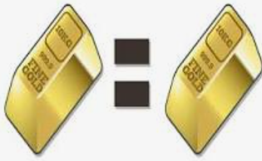





Bonus: More Characteristics of Money
Summary
Money has 6 characteristics. Note that money is usually not completely perfect across all the characteristics.
Durability
Objects used as money must withstand physical wear and tear
Portability
People need to be able to take money with them as they go about their business.
Divisibility
To be useful, money must be easily divided into smaller denominations or units of value.
Uniformity/Fungibility
Any two units of money must be uniform, that is the same, in terms of what they will buy.
Limited Supply
Money must be available only in limited quantities.
Acceptability
Everyone must be able to exchange the money for goods and services.
Eg. $1 dollar buys the same as another $1 dollar
Eg. 10 yuan can be broken into 1 yuan and 9 yuan.

Slide 14
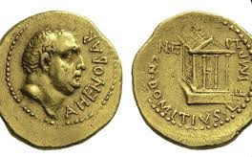
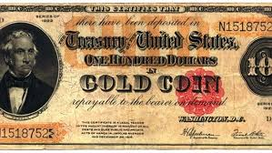
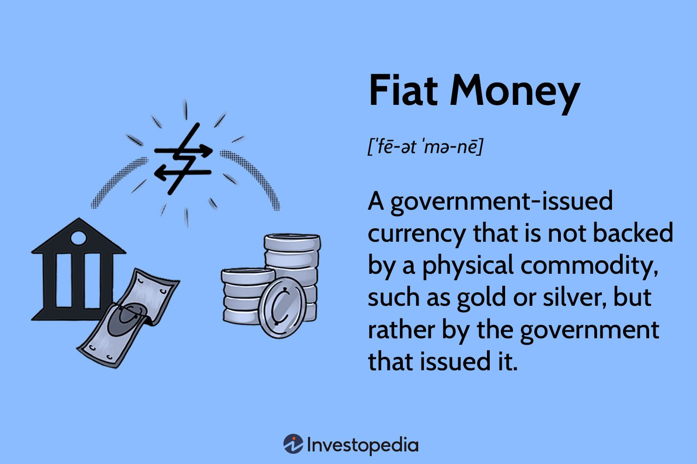
Fiat Money ie. Paper Money
Summary
Fiat money is paper money and the value is based on the guarantee that the money is universally accepted.
In the past and other cultures money has been made of precious elements such as gold.
Money of the past was often made out of precious metals such as gold and silver and was called commodity money. This worked in part because it had limited supply.
Fiat money – ‘paper money’ – this money is not linked to any real element. This is the most common form in the world today. The value of the money is based on the government guarantee that the money is universally accepted as payment.
Therefore a government can increase or decrease the amount money as much as they want.
Money made of gold/silver
Money is made of gold, the more gold, the more money.
Commonly used in ancient times.
Money is connected to the value of gold
Up until 1971, US dollars could be exchanged for gold at $35 per ounce
Pure fiat money
Money has no official connection to gold, only based on its guarantee by the government.
Almost all currencies today are fiat money.
Money is equal to gold
Money has no connection to gold

Slide 15


Real World Examples of Alternate Money
Crash Course – examples of money
Historical Context: The Rystones of Yap Island
On an island in the Pacific Ocean, the currency are huge stones called Rystones. Because they are so large, and therefore difficult to make, they are hard to counterfeit and this makes it a trusted currency.
Prison Money – What happens when money is banned?
In prison, inmates typically are prohibited or restricted from using money.
In these closed economies, people often find alternate forms of money to help make trade easier such as cigarettes, ramen noodles, or even packets of fish.
A Yap Island Ry Stone.
(1) Prison Economy | National Geographic - YouTube

Slide 16
What is fiat money?
Money that is not backed by any element. It is sometimes called ‘paper money’.
How is the supply of money different for a government with a fiat money system?
In a fiat system, there is no limit to the money supply; the government can increase/decrease money as much as they want because it is ‘paper money’.

Slide 17
5. What determines the real value of the United States dollar?
The quantity of money held as bank reserves
The money multiplier
The value of the gold backing the money supply
The goods and services the dollar will buy
The interest rate in the loanable funds market

Slide 18



Liquidity
Summary
Cash = the most liquid asset.
Assets vary in terms of their liquidity.
Liquidity refers to how easily an asset can be used in buying goods and services – the most common type of transaction.
Cash which means bank notes and coins, can always and immediately be used to buy goods and services – therefore it is the most liquid asset.
Digital Money in easy to access bank accounts and other accounts is the equally liquid because it can also be used everywhere.
A house is not very liquid because it will take a while to convert to cash.
You have to put the house up for sale, negotiate with buyers, sign documents and many other things! This process can take weeks or even months before you can finally convert it to cash!
Thought Experiment
Imagine trying to pay for a taxi with a brick from your house! This isn’t possible and so you would need to convert your house to cash first before being able to buy goods/services.
A Bartender Explains Liquid Assets - YouTube

Slide 19
Which is the most liquid asset?
Cash/digital money in easy to access accounts
Why is it the most liquid?
Because it can be used to make a transaction immediately where as other assets usually have to be converted to cash first.
Put these items in order of liquidity.
Shares, your retirement fund, your Wechatpay balance, US dollars in China, your laptop, a candy bar
Answer:
Wechat pay, US dollars, Laptop, Candy Bar, Shares, Retirement Fund

Slide 20
Money Aggregates – M1 and M2
The money aggregates are two groups within the total money supply.

Slide 21
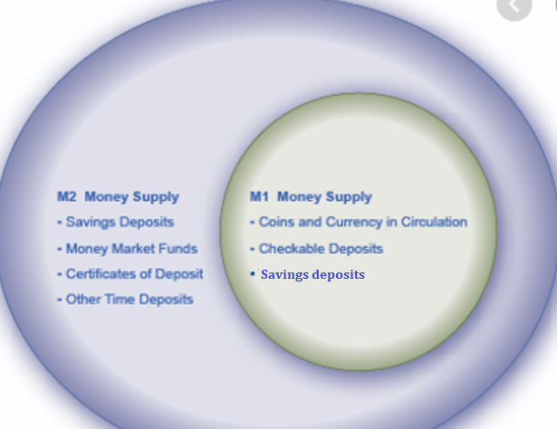

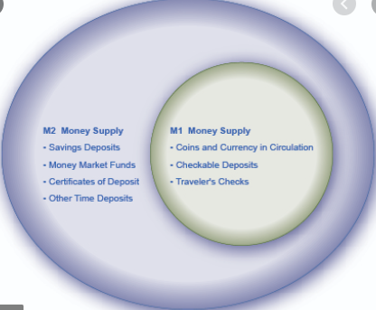

M1 and M2 Money
Note: One clue is to ask what the interest rate is. If the interest rate is higher, then the money is less liquid and therefore more likely to be examples of other types of money in M2.
Summary
M1 – liquid money
M2 – includes M1 + less liquid money
M1 money
Highly liquid
Cash, demand deposits, checkable deposits, savings deposits
M2 money
Broader definition of Money
Includes M1 + less liquid money
Certificates of deposit, Term Deposits, Money Market Funds
These are often called ‘near monies’ because they can’t be immediately used as money but are easily converted to money
Not Included:
Gift cards, municipal bonds (lower level gov bonds), gov bonds
Savings deposits
The main difference between M1 and M2:
M1 is more liquid and is easily used in transactions than M2.
M2 must be converted to M1 before it can be used for spending.
M2 INCLUDES M1 money.
“Remember that 2 is bigger than 1.”

Slide 22
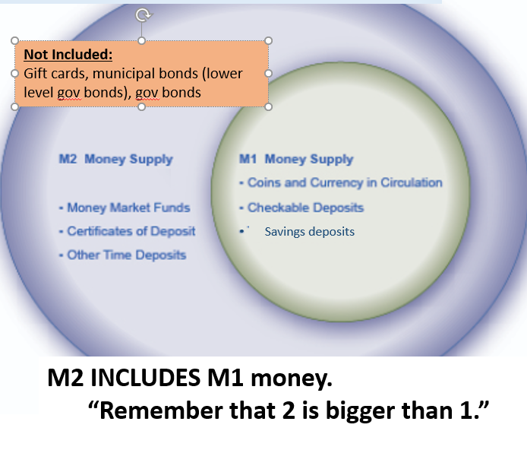

Slide 23
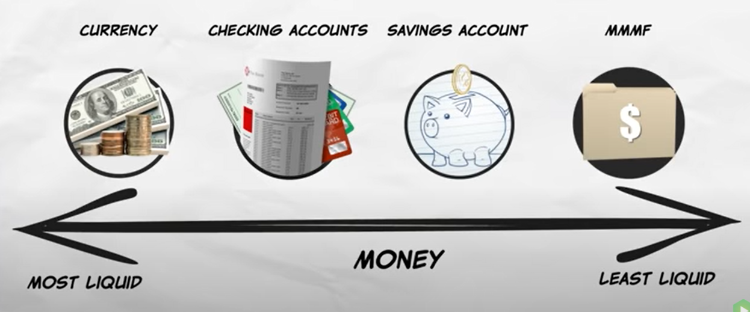
M1 or M2?
Money Market Mutual Funds
M1 (and M2)
M1 (and M2)
M1 (almost as liquid as checking accounts) (and M2)
M2 only

Slide 24
M2 (includes M1 but also less liquid monies)
M1 = more liquid forms of money
Liquid
Illiquid

Slide 25
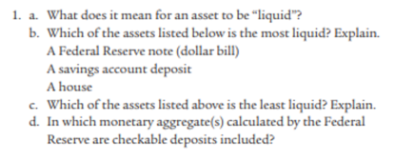
Module 23
Can be used in transactions immediately.
Dollar bill is cash = liquid
A house. Most difficult to convert to cash and use.
M1 and M2

Slide 26
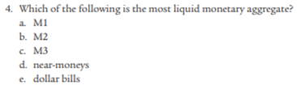
Module 23
Answer: a
Note: Since 2006, M3 is no longer measured by the US government.

Slide 27

Types of Bank Accounts
Summary
M1 bank accounts – can be assessed directly without permission.
M2 only bank accounts – can’t be assessed directly without permission.
We can divide bank accounts into those that are counted in M1 and those that are counted in M2 but not M1. This is determined by how accessible/liquid they are.
Can Pay for things without the need to ask for permission
These bank accounts which can be used for direct purchases are typically referred to as:
Checking Accounts
Demand Deposit Accounts
Demand Deposits
Checkable Deposits
Savings Accounts (not direct but easily accessible)
These are the accounts directly connected to your Wechat Pay and Alipay accounts
Must ask permission from someone to be able to use this money
Typically you will have to transfer to your demand deposit account/checking account before you can use for purchases.
You will also have to ask permission/communicate with a third party.
These accounts can be referred to as:
Term Deposits
Certificates of Deposit
They will typically pay a higher interest rate because the money is less accessible.
Note: Credit Unions essentially function the same way as banks but are non-profit, and are sometimes referred to in questions.
M1 (and M2)
More accessible/liquid
M2 only
Less accessible/liquid

Slide 28
M1 or M2? (m1 and m2 or just m2)
Cash you have in your Wechat balance.
Money in your bank accounts.
Money in a retirement fund.
Your grandmother gives you 500 RMB for your birthday.
Money stored in the bank for a long period and if you withdraw it you lose interest.
Remember: M1 money is also M2 money because M2 includes M1.
M1 (very liquid) and M2
M1 (liquid) and M2
M2 – not liquid
M1 (very liquid) and M2
M2 – not very liquid

Slide 29
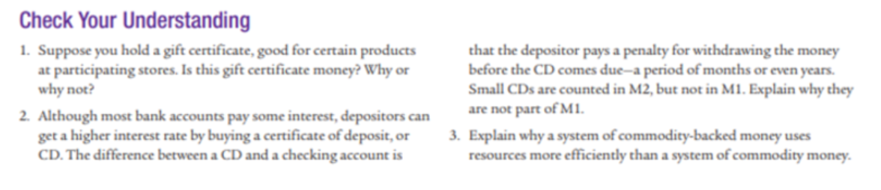

Certificates of Deposit are not liquid funds because they cannot be easily used in transactions and therefore not in M1.

Slide 30
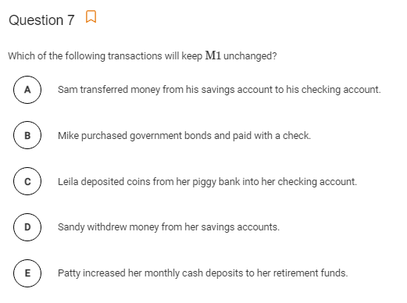
Answer: C
Coins = M1
Checking account = M1
So there is no change.

Slide 31
11. Which of the following includes only the most liquid assets?
M1 money
M2 money
stocks and bonds
mortgage-backed securities
mutual funds

Slide 32
12. Which of the following constitutes the largest component of the M1 money supply?
currency
coins
savings deposits
checkable deposits
traveler’s checks

Slide 33
13. What is the effect of a withdrawal of $500 from a checking account on the M1 measure of the money supply?
It does not change.
It increases by $500.
It increases by less than $500.
It decreases by $500.
It decreases by less than $500.

Slide 34
14. Nancy transfers $2000 from her savings account to her checking account. What is the effect on the M1 measure and the M2 measure of the money supply?
M1 M2
Increases by $2000 Increases by $2000
Increases by $2000 Decreases by $2000
Decreases by $2000 No change
No change Decreases by $2000
No change No change

Slide 35
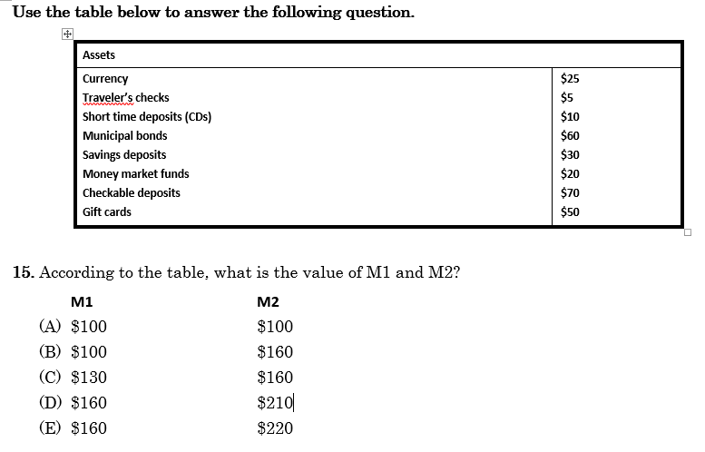
M1
M2
CDs = certificates of deposit
X
Municipal bonds = non-federal gov bonds
M1
M2
M1
X
Near monies but not in money supply
M1 = 25 + 30 + 70 = 125
M2 = M1 + 10 + 20
= 125 + 30 = 155
Answer: C
$155
Note: I will put this exact question (with slightly different numbers) in the next Quiz.
$125
$155

Slide 36
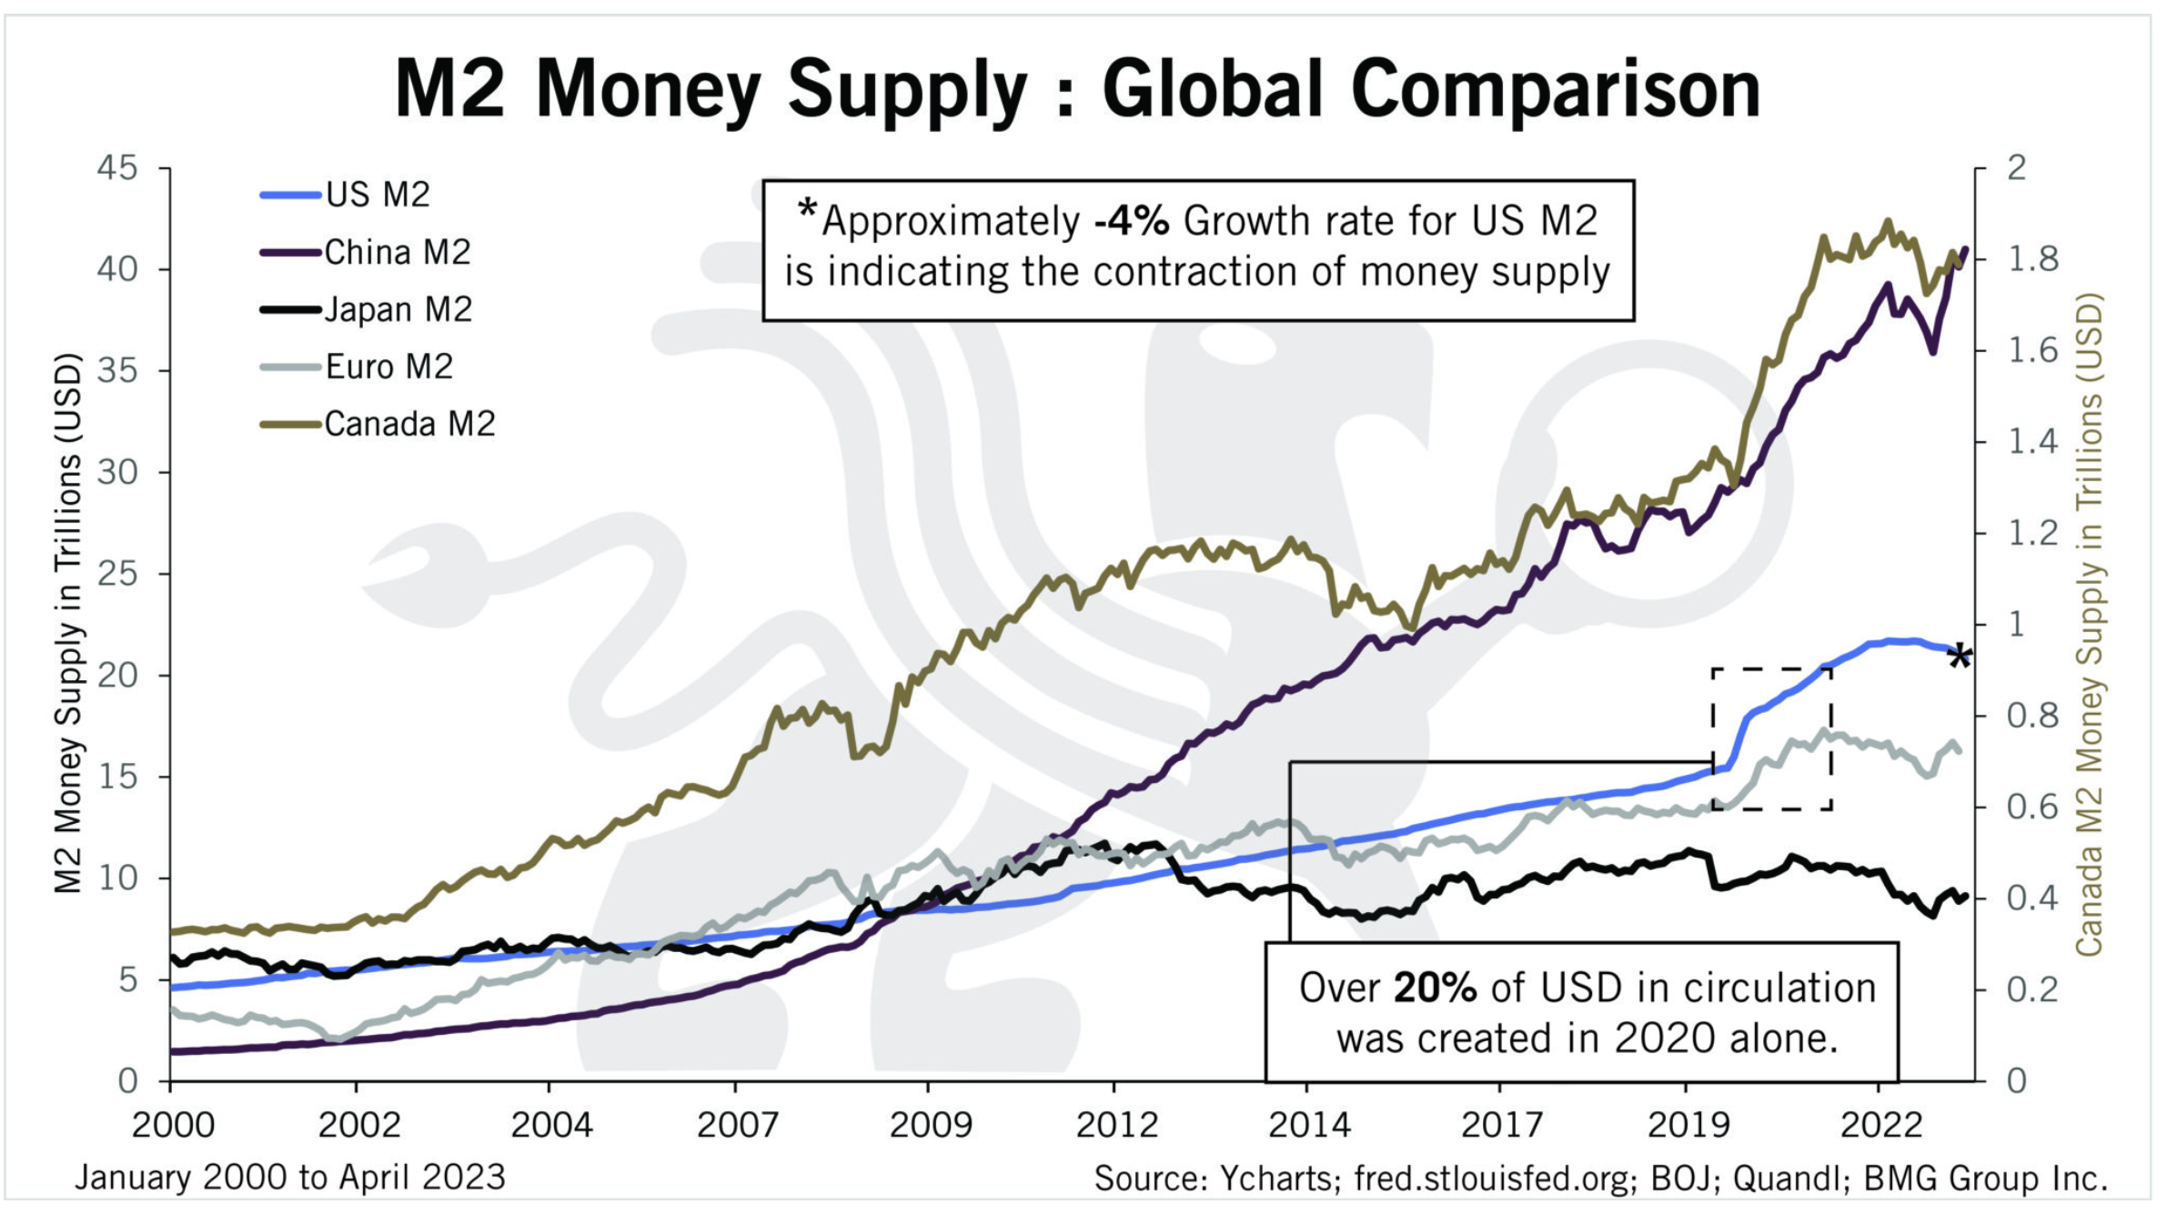
M2 Money Supply Around the World
Because all money today is fiat money (paper money), money supply is far easier to increase and decrease than before.
Many governments around the world increased the money supply during Covid to try and stimulate the economy.

Slide 37
True or False? Most M2 money supplies around the world have increased in recent years.
True

Slide 38
Money Aggregates – Monetary Base
We defined the money supply which comes in two categories, M1 and M2.
We also have the monetary base, which is closely related to the money supply.

Slide 39
Bank Reserves
Bank Reserves are an important thing to understand in Unit 4.
We will soon see that have a significant effect on money supply.

Slide 40

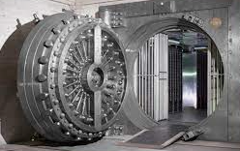
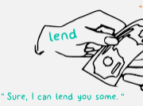
Bank Reserves
Your Deposits
What are bank reserves?
Simply, it is money that is put aside by the bank and kept ‘just in case’. This money is there if customers wish to withdraw their deposits.
The rest of the money can be lent out freely, or invested by the bank into other things.
Money that is kept in reserve.
Money that the bank lends out etc.
Summary
Banks keep reserves, which is money that is not lent out or used for other purposes. It is kept ‘just in case’

Slide 41
What are bank reserves?
Excess money that the bank keeps aside.
What does the bank do with the rest of its money?
Primarily lend, but also invest

Slide 42
400 Macro Questions
Answer: D
16. What are bank reserves?
Deposits that are held in the form of gold reserves
The sum of all loans a bank makes to borrowers
The value of investments a bank keeps in excess of the value of deposits
The fraction of deposits kept aside by the bank
The value of owner’s equity in the bank

Slide 43
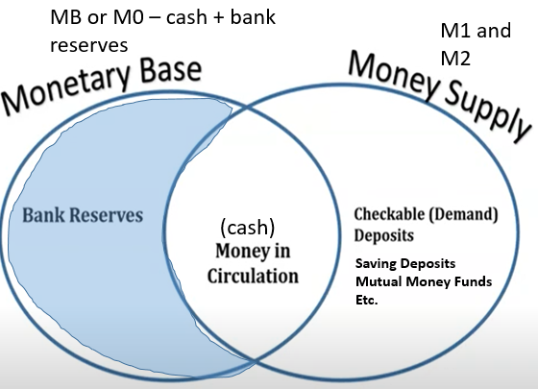
Monetary Base vs Money Supply
Monetary Base (M0 or MB)
Includes currency in circulation and bank reserves
Reserves (which are kept in the Fed vaults)
Money Supply (MS)
M1 and M2
Currency in circulation (M1)
Demand deposits (M1)
Traveller's Checks (M1)
Time Deposits (M2)
CDs (certificates of deposit) (M2)
Summary
Monetary base and Money Supply have different classifications.
Monetary base = bank reserves and cash.

Slide 44
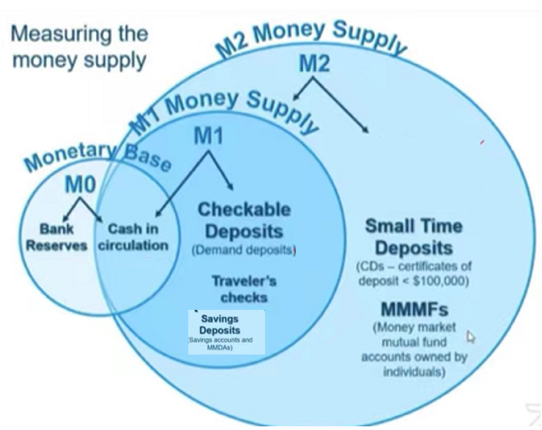
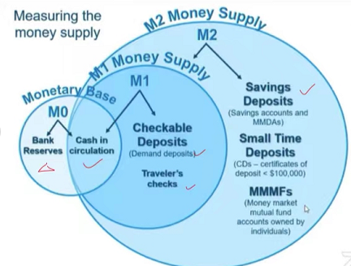


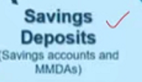

Money Aggregates Summary
Note: You may see higher aggregates of money such as M3 and even M4. The Fed stopped releasing reports on the M3 money supply in 2006 stating that it did not contain useful additional information.
M0 or MB is the monetary base
M1 is liquid money
M2 includes M1 but also less liquid forms of money
Narrow
Money
Broad
Money
Note: The above terms are sometimes used to describe M1 vs M2 money.

Slide 46
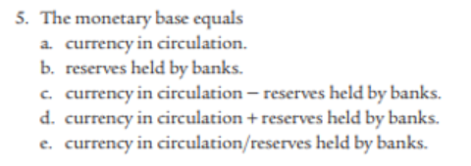
Mod 25
Answer: d

Slide 47
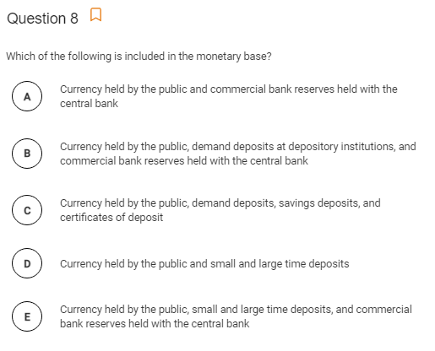
AP Progress Check (AP Website)
Answer: A

Slide 48
Financial Assets

Slide 49
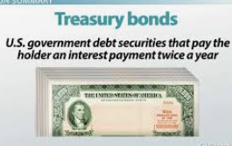
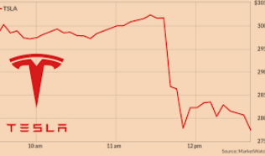
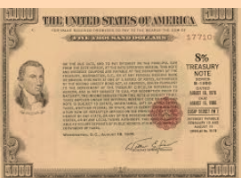
Financial Assets - Stocks and Bonds
Summary
Stocks = own a piece of the business.
Bonds – IOU. The owner of the bond will be paid back with interest. Many bonds are government bonds (lending money to the gov)
Depending on national laws, locals and foreigners are permitted to buy financial assets on international capital markets. Two common types of financial asset are stocks and bonds.
Debt based asset
Bonds
A ‘piece of paper’ which is an I.O.U. (I owe you) for the holder of the bond. They are paid back over a period of time which depends on the type of bond.
Selling a bond is really the same thing as borrowing money. Eg. If the US government sells bonds it is borrowing money from people that it will pay back in the future.
Commonly issued by governments eg. US Treasury Bonds to raise money for the government or conduct Monetary Policy (OMO)
Eg. You buy a bond from the US government. The piece of paper/contract that you hold says that the government must pay you back.
Stocks/Shares
Represents ownership / part ownership of a company
Eg. If there are 1000 shares and you buy 100 shares, you own 10% of the company
If a company is profitable, it will often pay out dividends (a share of profits) to the owners
Stocks can be sold quite easily on the stock market. The biggest stock market is the US stock market.
Equity/ownership based asset
Top 10 Largest Companies by Market Cap (1979-2021) - YouTube

Slide 50
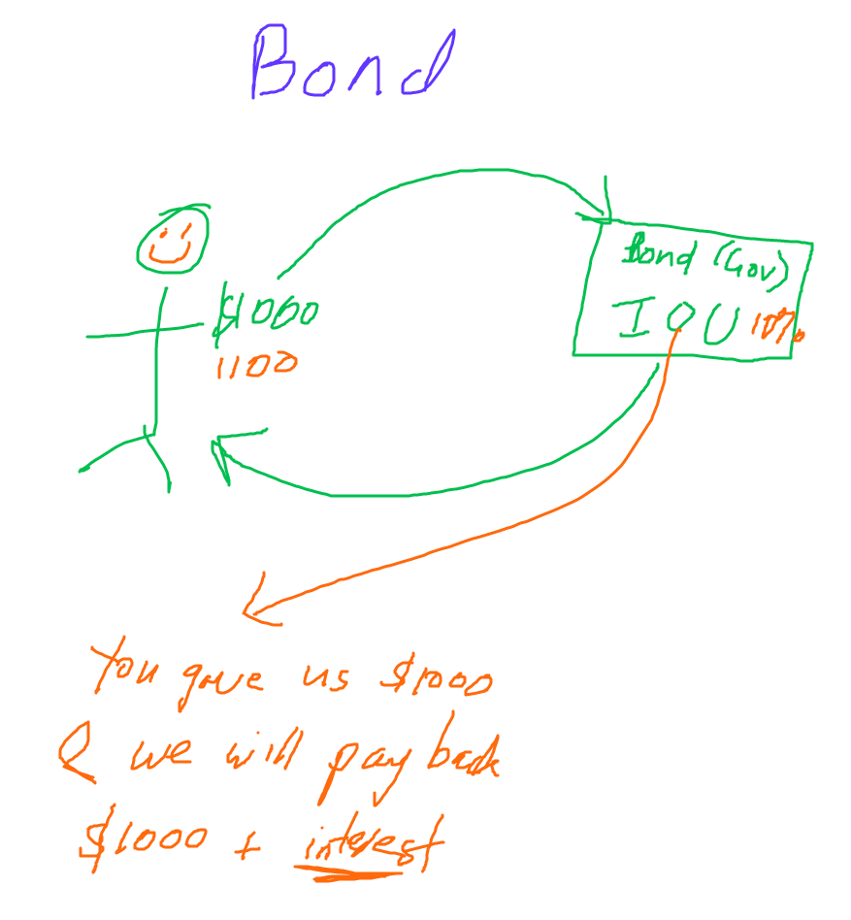
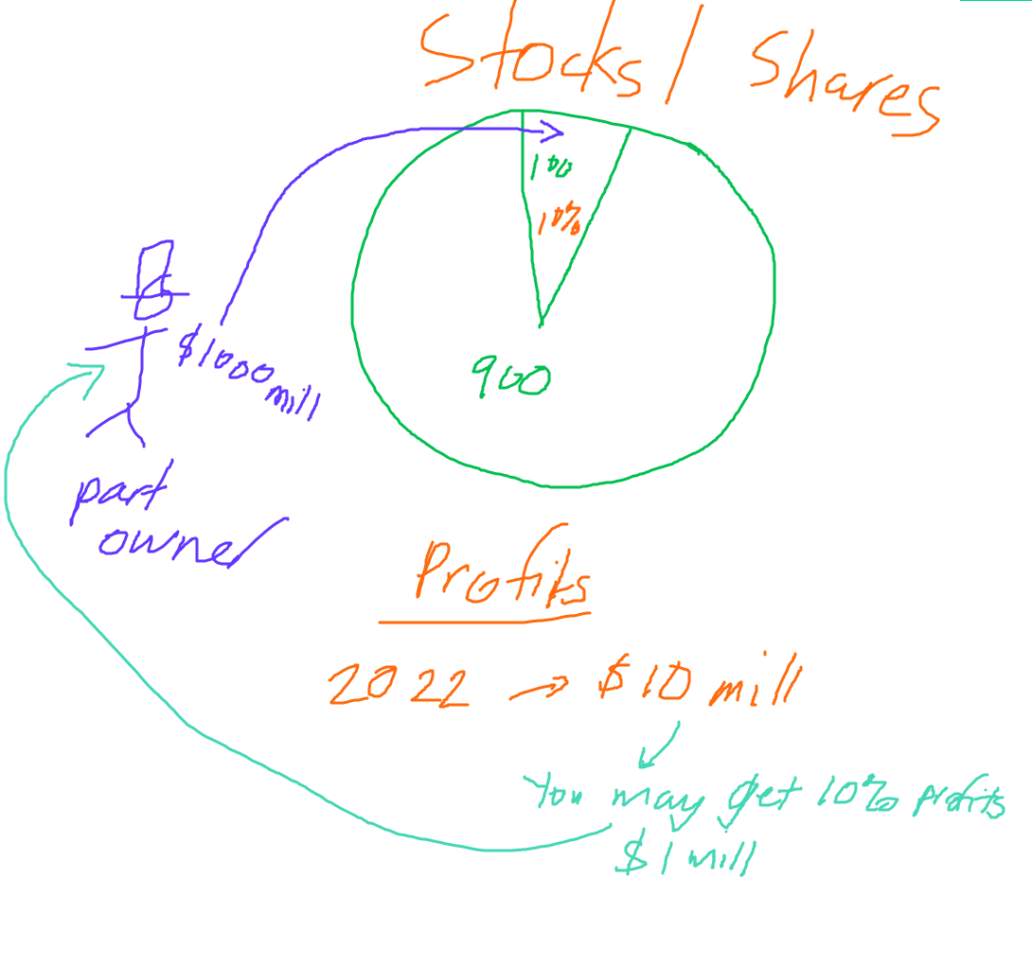
Makes money from interest
Makes money from the business’ profits
Summary
Bonds = An “I Owe You” Certificate.
Stocks = You own a piece of a company, you own a piece of equity
These are called ‘dividends’

Slide 51
Which financial asset involves the part ownership of a business? Stocks/shares or bonds?
Stocks/shares.
Eg. Buy 3 shares of Apple stock.
Which financial asset involves a certificate which states the repayment of this debt? Stocks/shares or bonds?
Bonds.
Eg. You buy a government bond.

Slide 52
The money that you gain from holding a bond is called?
Interest
The money that you gain from holding stocks/shares is called?
Dividends (a share of the profit)
Bonus: How else can you make money from stocks/shares?
You can buy for a price and sell when the stock goes up.
Bonus: Does an investor care if they earn $500 from interest or $500 from dividends?
No.
They have different names but are both ways of earning money.

Slide 53
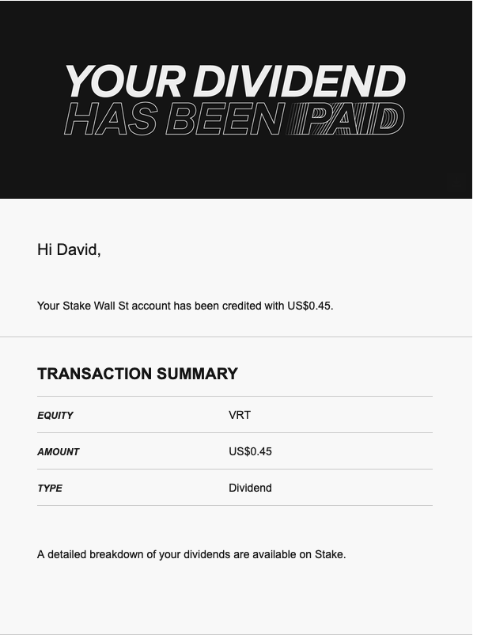

Slide 54
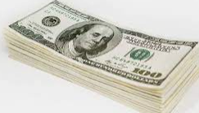



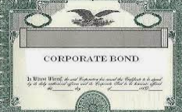
Bonds – more detail
Original Amount
Eg. $1000
Definitions
Original Amount – the original amount that must be repaid (written on the ‘face’ of the bond)
Interest– the interest rate of the bond paid per period
The interest rate is fixed!
Bonds have a lifetime depending on the type of bond.
Eg. A 10 year bond pays interest for 10 years.
Often the government
Bond seller / Borrower
Pays back the principal $1000 + regular interest payments (coupon rate)
Bond buyer / Lender
Types of Bonds
Treasuries – US Government Bonds
Bonds – 10 yrs +
Notes – 2 to 10 years
Bills – 1 year or less
Corporate Bonds
Bond Ratings:
AAA – best
BBB – medium risk
Bb or lower – high risk ‘junk’ bond
Summary
Bonds are ‘certificates of repayment’
Bonds have a lifetime depending on the bond type.
Bond buyer = lender of money
Bond seller = borrower of money
An individual who buys a bond, for an original amount receives a certificate that entitles them to be paid back the principal + interest. The size of these regular payments is the coupon rate.

Slide 55
You buy a Government Treasury Bond for $1000 which will pay interest for 10 years. Are you the ‘borrower’ or ‘lender’ in this situation?
You are the lender because the government will pay back the principal = $1000 plus interest over time.

Slide 56


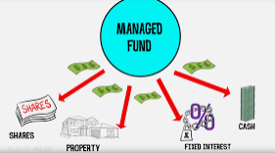
Some Other Financial Assets
Summary
Money! – used to buy things.
Loans – money that must be paid back
Certificate of Deposit – long term bank account that pays high interest. Managed funds - professionals invest your money for you
Money – cash, bank account funds – no list of financial assets is complete without money! We can use money to buy the things we need!
Loans – borrowing money which must be paid back with interest.
Just like bonds, it is debt that will be paid back.
Mortgage
This is a loan for people to buy a house. It is therefore usually a very long term loan.
Certificates of Deposit – this is similar to you depositing money in the bank but is more long term. It pays a higher interest but you can’t touch the money until the end of the period or you give up the interest.
Money Market Funds
These are where many individuals give money to professionals who invest it for you. Hopefully they will be able to grow your money.
Mutual Funds
Pension / Retirement funds

Slide 57
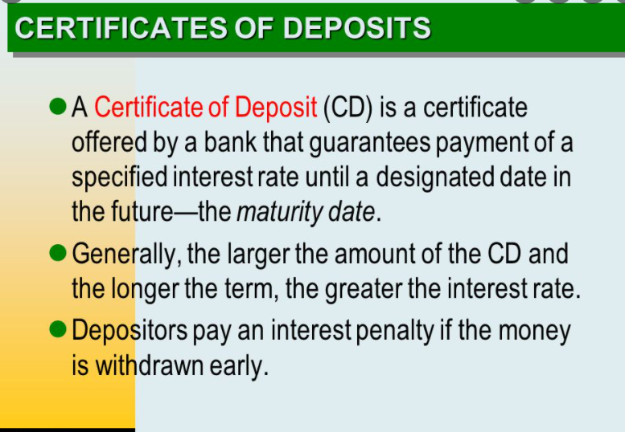
A certificate of deposit is a ‘certificate’ that you receive when you keep money in a bank for a long time.
You receive more interest than your usual bank account but are not allowed to touch the money.

Slide 58
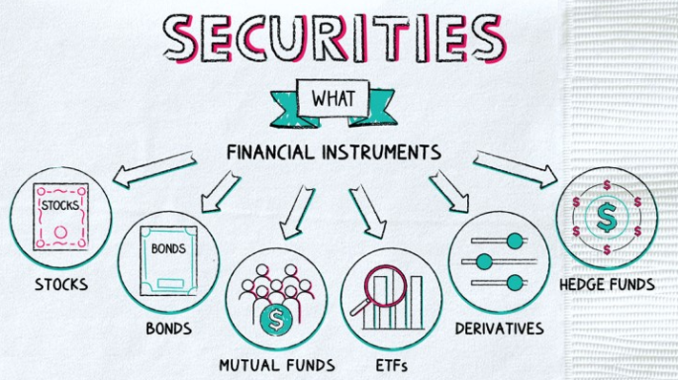
Term - Securities
Summary
The term ‘security’ is often used to describe a financial asset. This can be used for many different financial assets.
It is an official term that is used to describe financial assets.
When you purchase a security, you are essentially purchasing a certificate that says that the financial asset belongs to you.
In the past this would have always been a very hard to copy, physical certificate but nowadays is often a digital copy.

Slide 59
What are the two most common financial assets we have looked at? Which of these pay interest?
Bonds – pays interest
Stocks/shares – pays a share of profit called dividends.
What are some other financial assets?
Mutual funds – you give money to professionals who invest for you.
Certificates of deposit – you save money in the bank for a longer period and get paid more interest.
Cash
What is a certificate of deposit?
It is a fancy way of saying: long term bank account. When you put your money in this account, you are given a certificate.
What is an advantage and a disadvantage of keeping your money in a certificate of deposit compared to a normal bank account?
Advantage: you can earn more interest.
Disadvantage: you cannot touch your money or you’ll give up the interest.

Slide 60
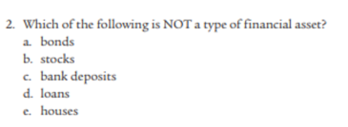
Mod 22
Answer: e

Slide 61
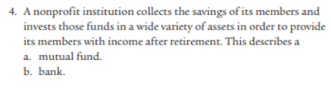

Mod 22
Answer:
Answer: a

Slide 62
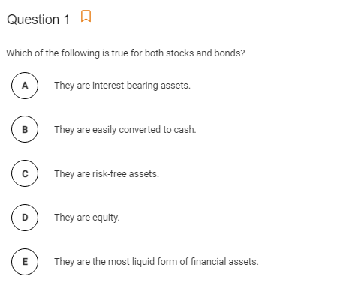
Answer: B
Quite easy to sell these on the open market.

Slide 63
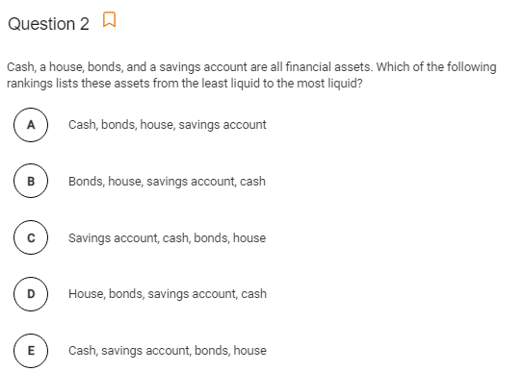
Answer: d
The house is a huge hint.

Slide 64
400 Macro Questions
Q 1-6

Slide 65
Which asset is a share in the ownership of a company held by a shareholder?
Bond
Dividend
Mortgage
Mortgage-backed security
Stock

Slide 66
2. What is the benefit when a household purchases a bond?
The promise of future income in the form of interest payments.
A share of ownership of a company
The ability to exchange the bond for goods and services
Ownership of a piece of property
Dividend payments from a corporation

Slide 67
3. Which of the following is a financial asset?
A share of ownership in an auto company
An apartment building
A textile factory
A government bond
I only
II only
I and IV only
II and III only
I, II, III, and IV

Slide 68
More on Bonds
2nd Hand Market for Bonds
The Price of 2nd Hand Bonds

Slide 69

2nd Hand Market for Existing Bonds
Original amount
Eg. $1000
A big difference between bonds and loans is that bonds can be sold before they expire/reach maturity.
The repayments now go to the new bond holder.
Often the government
This price of the second hand bond will be lower than the original amount for the new bond because bond has been partly paid off)
Eg. $500
Pays back the face value $1000 + regular interest payments
Original Bond buyer / Lender

Slide 70
You bought a bond which pays x% interest. Instead of waiting for the bond to pay you back over a long period, what can you do?
You can sell your bond on the second hand market for bonds.
Eg. You have a 5 year bond that has 3 years left. You decide to sell it on the second hand bond market. Now the new owner of the bond will receive the interest payments.

Slide 71
Total Bonds In Circulation
The vast majority of bonds in circulation are older; issued in previous years.
New Bonds issued this year

Slide 72
True or False? The majority of bonds that are in circulation are issued in the current year.
False

Slide 73


Interest Rate Effect on Bond Price Example
Summary
2nd hand bonds will be more attractive if they pay a higher interest rate than the market interest rate.
And vice versa.
Let’s say we have a 5 year bond where the original amount was $1000 and the interest rate is 5%.
High Market Interest Rates eg. 10%
Now our bond and it’s coupon rate will not appear that great because there are other options that pay higher interest. So people will be less willing to buy this bond and so the bond price falls.
Low Market Interest Rates eg. 1%
Now our bond will pay higher interest than other assets and will appear amazing compared to the 1% interest rate. People will be willing to pay a higher price for the bond.
Government
↓Price of the bond
↑Price of the bond

Slide 74

Investors
Old bonds
3% Interest
New bonds and other interest bearing assets
4% Interest

Slide 75
What happens to the price of a bond that pays 2% interest if the interest rate in the economy increases?
The bond’s interest isn’t as high compared to the interest rate now. So people will prefer to put their money where interest is higher.
So ↓price of bond

Slide 76
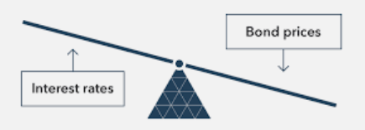
The Price of Bonds
Note: Loans tend to be more strongly linked to one borrower and one lender, and therefore can’t be sold on the open market.
Bonds can be bought and sold on the open market.
Bonds have a lifetime until the debt of the bond has been repaid – called reaching maturity. When all the money and interest is repaid, the life of the bond ends – it reaches maturity.
However, before the bond reaches maturity, the owner of the bond can sell their bond to someone else (just like you can sell a 2nd hand phone or bike before it dies/breaks completely).
(2nd hand bond)
How the Interest Rate Affects Bond Price
The price of the bond being sold is determined by the current market interest rate.
If the interest rate is higher than the bond’s interest rate doesn’t seem as attractive. Therefore the bond’s price will be lower.
If the interest rate is lower than the bond’s interest rate is more attractive. Therefore the bond’s price is higher.
(market interest rates eg. For NEW bonds)
Summary
Bonds can be resold on the open market before they are completely paid off.
High interest – bond price lower
Low interest – bond price higher

Slide 77
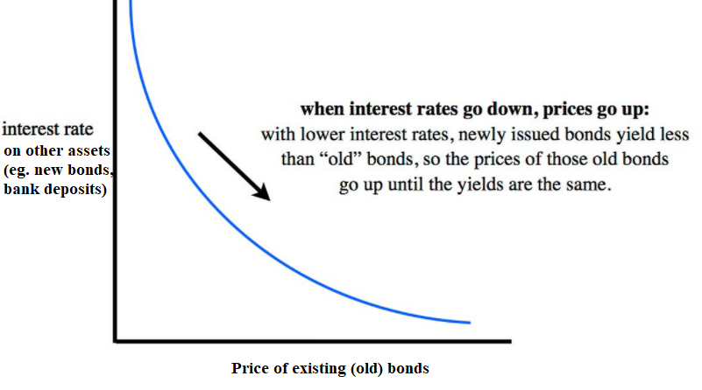
Graphical Relationship between Bond Prices and Market Interest Rates
Summary
Remember that the interest rate and (old) bond prices are inverse.
Higher IR makes old bonds less attractive.

Slide 78
What is the relationship between the price of (old) bonds and the current interest rate?
Negative Relationship
When the interest rate is higher, old bonds are less attractive because the returns on these bonds are not as good compared.
When the interest rate is lower, old bonds are more attractive because the returns on these bonds are now better than the market interest.

Slide 79
You have a bond with a coupon rate of 5%. The market interest rate goes down from 3% to 1%. What happens to the price of your bond?
The price of your bond will go up because the coupon rate (interest rate) is super attractive now to investors.

Slide 80
Bonus: Bond Terms
Principal
Eg. $1000
Now that we know that bonds can be sold on the 2nd hand market, we need some new terms to distinguish between old and new bonds.
Definitions
Face Value – the original around that must be repaid
Principal – how much the bond was bought for. (For a new bond, face value = principal, for an old bond face value may not equal principal.)
Coupon rate – the interest rate of the bond paid per period
Bond yield – another word for the coupon rate compared to the principal (this could be different to the coupon rate because the principal and face value could be different)
Often the government
Bond seller / Borrower
Pays back the principal $1000 + regular interest payments
Bond buyer / Lender
Types of Bonds
Treasuries – US Government Bonds
Bonds – 10 yrs +
Notes – 2 to 10 years
Bills – 1 year or less
Corporate Bonds
Bond Ratings:
AAA – best
BBB – medium risk
Bb or lower – high risk ‘junk’ bond
An individual who buys a bond, for a principal amount receives a certificate that entitles them to be paid back the principal + interest. The size of these regular payments is the coupon rate.

Slide 81
The Opportunity Cost of Holding Money

Slide 82
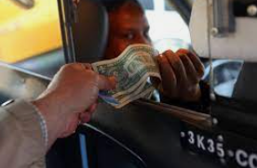


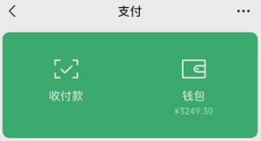



Holding Liquid Money
Summary
Holding liquid money is convenient for our daily needs.
When we say ‘holding money’ we mean the taking out of liquid money (cash or digital money) in order buy the things we need and want.
Therefore, holding liquid money is convenient for our everyday activities!
However, we will soon see that this convenience comes at a cost.

Slide 83


Opportunity Cost of Holding Liquid Money
Opportunity Cost
Recall that opportunity cost is the cost that comes from any decision that we make because we give up the next best option.
Liquid money is convenient, it does not pay us interest (or extremely low interest) when we hold it to use.
Usually the less liquid the money, the higher the interest rate.
We assume that the next best thing we can do with our money is to invest it in financial assets such as bonds or long term bank accounts. It is less convenient but it will pay us interest.
Therefore, this is the opportunity cost of liquid money – the interest we could have earned from other financial assets.
Option 1:
Keep cash or keep money in your Wechat pay account with 0% interest and use it to buy various things.
Option 2:
Keep money in an interest bearing account or buying a financial asset which pays 3% interest per year.
Opportunity Cost of Option 1 is the benefits of Option 2 ie. The 3% interest.
Summary
Holding money has an opportunity cost of the interest you could have earned by buying an interest bearing asset (an asset that pays interest).

Slide 84
Why do people hold liquid money?
For the convenience of buying the things we need.
What do we assume is the opportunity cost of holding liquid money?
OC = interest we could have earned if we bought an interest bearing asset.
Eg. A bond, put money in a high interest bank account (eg. term deposit)

Slide 85
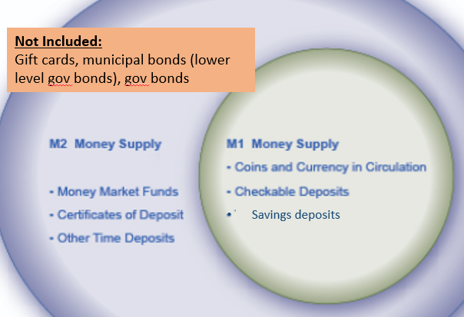
Financial Assets Summary
Opportunity Cost of Money
Holding money has an opportunity cost of the interest you could have earned by putting in a savings account/investing.
Money
Bonds – debt asset. Pays interest to owner of the bond
Stocks – equity/ownership asset. Pays share of profit called dividends.
Certificates of Deposit – depositing money in a bank for a longer period which cannot be touched or the interest is not paid.
Mutual Funds – money given to professionals who invest it for you. Eg. Retirement Fund
Fiat Money
Money that has no backing and can be increased without limit by the government.
Definition: can be universally accepted as a medium of exchange.
Money
Medium of Exchange – used to buy goods and services
Store of Value – we can hold money and spend it in the future.
Unit of Account – we can measure the value of things using money.
Liquidity – how easily something can be used to buy things. Cash/easy access digital money is the most liquid asset.
More on Bonds
Bonds can be sold before they reach maturity. They can be sold in the second hand market for bonds. Eg. You buy a 5 year bond but decide to sell it after 2 years.
Relationship of (second hand) bond price to interest rate.
Higher Interest Rate makes second hand bonds less attractive.

Slide 86
Real Interest and Nominal Interest

Slide 87
We have looked at bonds which pay interest to the bond-holder.
Therefore we can revise our knowledge of Real vs Nominal Interest which we covered in Unit 2

Slide 88
Which one is the best deal?
Summary
Knowing inflation can help us to calculate the real interest rate.
Country 1
Country 2
You put 100 dollars in the bank.
The bank pays you 10% interest.
The inflation rate is 15%
You put 100 dollars in the bank.
The bank pays you 5% interest.
The inflation rate is 3%
Logically we can see that country 2 is the best deal, because your money is growing faster than the prices.
We can see that the Real Interest Rate is the most important and not the Nominal Interest Rate. Knowing the inflation is important.

Slide 89
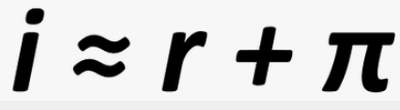
The Fisher Equation and Interest
Borrowing and Interest Review
When an individual borrows money, they are usually expected to pay it back ‘with interest’.
Eg. You borrow $1000 and pay 5% interest. Therefore you will pay back $1050.
Logically, because Inflation decreases the value of money, interest payments are worth less.
This relationship can be stated mathematically
It was identified by the economist Robert Fisher and is therefore called the Fisher Equation.
Real Interest = Nominal Interest – Inflation
Or
Nominal Interest = Real Interest + Inflation
i = nominal interest
r = real interest
Π = inflation
Eg. The bank charges lends money and charges 5% interest for its the inflation rate is 2%. The real interest rate is 5-2=3%.
Summary
Nominal interest = the number cost of borrowing
Real interest = the true cost of borrowing
Real interest = nominal interest - inflation
Consequences of Inflation Home

Slide 90
What is the equation for real interest rates? (Note: Also called the Fisher Equation after the economist Robert Fisher.)
Real interest rate = Nominal Interest Rate – Inflation
Inflation decreases the value of money that borrowers have to pay back, even though the number they pay back is the same.

Slide 91
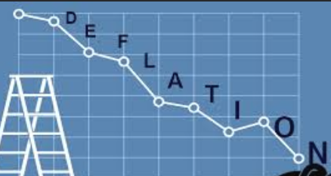


Winners and Losers
Unexpected/Unanticipated Deflation (Negative Inflation)
-> Lower Actual Inflation
-> Higher RIR (=NIR – Inflation)
Lenders win.
Borrowers lose.
Unexpected/Unanticipated Inflation
-> Higher Actual Inflation
-> Lower RIR (=NIR – Inflation)
Borrowers win.
Lenders lose.
No Unexpected Inflation/Deflation
-> Actual Inflation is the same.
-> RIR is the same.
If there is no unexpected inflation or deflation, then there is no winner or lower!
Summary
Unexpected inflation -> borrowers win
Unexpected deflation -> lenders win
No unexpected inflation/deflation -> no winners or losers

Slide 92
How To Solve Questions With Expected and Actual Inflation
Expected Situation
RIR = NIR – Inflation
= 5% – 3% = 2%
In order to solve these questions it can be logical to calculate two situations;
1. the expected situation
2. the actual situation.
Eg. A bank pays 5% nominal interest and expected inflation is 3% where as actual inflation is 2%. Who gains and who loses?
So the Actual Real Interest is more than expected, therefore the lender gains and the borrow loses. (Lenders receive interest and borrowers pay the interest)
Actual Situation
RIR = NIR – Inflation
= 5% – 2% = 3%

Slide 93
If there is unexpected inflation, what happens to the real interest rate?
Decreases.
RIR = NIR – Inflation. If there is unexpected inflation, actual inflation is greater, therefore RIR is lower.
Does this benefit the borrower or lender?
Borrower. They want to pay a lower real interest rate.
If there is unexpected deflation, what happens to the real interest rate?
Increases.
RIR = NIR – Inflation. If there is unexpected deflation, actual inflation s lower, therefore RIR is higher.
Does this benefit the borrower or lender?
Lender. They want to receive a higher real interest.

Slide 94
Fixed vs Variable Nominal Interest
Fixed Nominal Interest
Most questions involve fixed nominal interest
Fixed = does not change
Variable Nominal Interest
Variable interest is the opposite of fixed interest
Variable = does change
Variable interest is common in the real world but in our course often the questions focus more on fixed interest.
Variable interest typically has no winners and losers.
Eg. The variable interest will go up and down with inflation. So if we have unexpected inflation, the NIR will also go up, so the RIR will stay the same. Therefore no winners or losers.
Eg. RIR = 5 – 2 = 3. With unexpected inflation to 3%, RIR = 6 – 3 = 3. The NIR went up so that RIR was unchanged.
Can have winners and losers
No winners and losers

Slide 95
The bank believes there will be 5% inflation this year, but the actual inflation is 7%. Who gains and who loses assuming we have fixed nominal interest rates?
Expected: RIR = NIR – 5%
Actual: RIR = NIR – 7%
Even without knowing the NIR, it is the same in both cases, therefore the Actual RIR < Expected RIR.
Therefore the borrower wins and the lender loses
(Borrower pays less real interest)
What about if there are variable nominal interest rates?
There would be no winners and losers.

Slide 96



Winners and Losers from Inflation – Knowledge Levels
Real Interest Rate = Nominal Interest Rate - Inflation
B Student
“Inflation benefits borrowers and deflation benefits lenders”
A- Student
“Unexpected inflation benefits borrowers and unexpected deflation benefits lenders.”
“Expected inflation/deflation has no winners and losers.”
A+ Student
“Unexpected inflation benefits borrowers and unexpected deflation benefits lenders ONLY with fixed nominal interest rates.”
“Variable interest rates will have no winners and losers.”

Slide 97
Who are the winners/losers if the expected inflation increases?
No winners and losers.
Who are the winners/losers if the unexpected inflation increases with a fixed nominal interest rate?
Borrowers win and lenders lose.
Because RIR – NIR – Infl, therefore RIR increases.
Who are the winners/losers if the unexpected inflation increases with a variable nominal interest rate?
No winners and losers.
We assume that the nominal interest will change with inflation.

Slide 98

If the question doesn’t say we can assume fixed interest rates.
Borrowers gain

Slide 99


Bonus: Expected vs Unexpected Inflation
In many different ways we make guesses about the future (eg. the weather, stocks, politics etc.)
We also make guesses about future inflation.
The inflation that we expect is called expected inflation or anticipated inflation.
The inflation that we did not expect is unexpected inflation or unanticipated inflation.
We can express the relation between these mathematically:
Just as we predict the weather, we try to predict inflation.
Actual Inflation = Expected Inflation + Unexpected Inflation

Slide 100
The bank believes there will be 5% inflation this year, but the actual inflation is 7%. What is unexpected inflation?
Actual inflation = Expected + unexpected inflation
Unexpected inflation = 7-5 = 2%
The bank believes there will be 5% inflation this year, but the actual inflation is 3%. What is unexpected inflation?
Actual = expected + unexpected
Unexpected inflation= -2%
Therefore there is 2% unexpected DEFLATION

Slide 101
Summary – Nominal and Real Interest Rate
Nominal interest is decided by the bank and is the percentage you pay as a number. However, the real interest rate shows the true cost of borrowing and depends on the change of price level (inflation/deflation) as well.
Winners and Losers
Expected vs Unexpected Inflation/Deflation
Expected Inflation/Deflation
No winners/losers
Unexpected Inflation/Deflation
Inflation – borrowers win because RIR is lower
Deflation – lenders win because RIR is higher
Variable vs Fixed Nominal Interest Rate
Variable Nominal Interest Rate
No winners and losers
Fixed Nominal Interest Rate
Can have winners and losers
RIR = NIR - Inflation
Real Interest = Nominal Interest – Inflation
Or
Nominal Interest = Real Interest + Inflation
Example with Actual vs Expected Inflation
If actual inflation is 3% and expected inflation was 4%, who gains and who loses? Let’s say the Nominal interest rate = 5%
Actual Situation:
Real Interest Rate = 5 – 3 = 2%
Expected Situation:
Real Interest Rate = 5 – 4 = 3%
So the actual real interest rate is lower than expected. Borrowers benefit and lenders lose.
Actual Inflation = Expected Inflation + Unexpected Inflation

Slide 102
Unit 4 Progress Summary
Real Interest = Nominal Interest – Inflation
Nominal Interest = Real Interest + Inflation
Actual Inflation = Expected + Unexpected
Financial Assets
Bonds – debt asset. Pays interest to owner of the bond
Stocks – equity/ownership asset. Pays share of profit called dividends.
Certificates of Deposit – depositing money in a bank for a longer period which cannot be touched or the interest is not paid.
Mutual Funds – money given to professionals who invest it for you. Eg. Retirement Fund
Unexpected inflation benefits borrowers when there are fixed interest rates.
Unexpected deflation benefits lenders when there are fixed interest rates.
But when the interest rate is variable there are no winners and losers.
Money
Definition: can be universally accepted as a medium of exchange.
Liquidity – how easily something can be used to buy things. Cash/easy access digital money is the most liquid asset.
Medium of Exchange – used to buy goods and services
Store of Value – we can hold money and spend it in the future.
Unit of Account – we can measure the value of things using money.
Opportunity Cost of Money
Holding money has an opportunity cost of the interest you could have earned by putting in a savings account/investing.
Fiat Money
Money that has no backing and can be increased without limit by the government.
Relationship of (second hand) bond price to interest rate.
Higher Interest Rate makes second hand bonds less attractive.

Slide 103
The Financial System

Slide 104


The Financial System
Summary
The most simplified definition of the financial system is to act as an intermediary between those with surplus money borrowers who can use the money for various purposes.
The financial system is a large and complex system that involves many different financial products.
However, if we take the most simplified version of the financial system: taking the excess money of savers and lending it to those who want to borrow.
Related Terms:
Providing credit, providing liquidity (lender’s perspective)
Taking on debt (borrower’s perspective)
Loans, also called ‘providing credit’
Can use this money to invest and consume.
Savings
Pay back Loan
+ Interest
Interest
Note: The interest that the bank charges borrowers is higher than the interest it pays for your savings. That is how the bank makes money!

Slide 105


Benefits of a Financial System
By acting as this intermediary, they benefit society by:
Reducing Transaction Costs
People who save don’t have to worry about expending time and effort finding someone to lend to
People who borrow don’t have to expend time and energy asking hundreds or thousands of different people
Reducing Risk – diversification
When you save money in a bank, you are essentially lending your money to thousands of different people because this is what the bank does with your money.
This has less risk because it is much less likely that a thousand people won’t pay you back
Providing Liquidity
Liquid money is needed by businesses and individuals to purchase goods and services which boosts the economy. Banks make it far easier for people to access liquid money on short notice.
“Don’t put all your eggs in one basket.”

Slide 106
What are two benefits of having a well functioning financial system?
Reduced transaction costs
Reduced risk
Provide liquidity when it is needed
What would you do if you wanted to borrow money without a well functioning financial system?
You would have relatively few options beyond borrowing from friends and family.

Slide 107

Mod 22
Answer: d

Slide 108

Mod 22
Answer: B

Slide 109


Mod 22
i) Transaction costs: b / a, c
ii) risk: a, b, c
iii) liquidity: c, b, a

Slide 110


The Federal Reserve
The Federal Reserve is the name of the US Central Banking Authority / Reserve Bank, often referred to as ‘The Fed’
The Fed performs several roles:
Provide financial services – the ‘banker’s bank’
Supervise banking system – ensure that rules and regulations are followed to ensure the overall health of the financial system
Conduct Monetary Policy – this is the main topic of Unit 4 which we will cover in more detail.
Summary
The central bank in the US is called the Federal Reserve aka. The Fed
It serves to manage the financial system and conduct monetary policy.

Slide 111

Federal Reserve and Politics
The Federal Reserve is designed to be independent of the political process (though this may not always occur in practice).
In this way the goal of the Federal Reserve is to make decisions that are best for the economy and not be as swayed by popular opinion.
The Chairman of the Federal Reserve is appointed by the president and we have seen in recent history that Presidents from both sides of politics have often kept Chairman’s in their position.
Jerome Powell was appointed by President Trump in 2018 and continued to serve under President Biden and Trump’s second term. This indicates that the position is less political than other government positions.
Summary
The Federal Reserve is supposed to be independent. It does not have to listen to the government.

Slide 112







Slide 113
What is the name of the Central Bank in the United States?
The Federal Reserve often abbreviated to ‘the Fed’.
What are some of the roles of the Central Bank?
To regulate the financial system.
To act as the ‘banks’ bank’
Perform Monetary Policy
To fight against inflation.
Does the Fed have to listen to the government in power at the time?
No, it is (at least in theory) a non-political entity that makes decisions based on the best economic theory available.

Slide 114
Quiz 11 Coverage
Financial Assets
Stocks/shares, bonds, Mutual Funds, Certificates of Deposit
Bonds and certificates of deposit pay interest because they are debt based assets
Liquidity – cash is the most liquid asset
Opportunity Cost of Holding Money
Second Hand Bond Prices and the Interest Rate
Nominal vs Real Interest Rate
Fisher effect: Real Interest = Nominal Interest – Inflation
Unexpected Inflation – borrowers win and lenders lose
Money
Liquidity – cash is the most liquid asset
Definition of money
Functions of money
Types of money (fiat money, commodity money)
M1, M2 money supply
Financial System ie. Banks
Benefits of banking system:
Transaction costs lower
Risk lower (diversification)
Providing liquidity (ie. Providing cash to people/businesses who need it)

